Slide 1


Interim Presentation
Enabling second-life battery production.
Notes:
We’re going to present what we’ve done so far and our plans for future progress.

Slide 2
Our objectives have changed.
Notes:
(AMY)

Slide 3
Recap on key terms
EIS - Electrochemical Impedance Spectroscopy
ICA - Incremental Capacity Analysis
ECM - Equivalent Circuit Model
SOC - State of Charge
SOC - State of Health
Notes:
(AMY)

Slide 4
Our new objectives
Clean, process and visualise the EIS data.
Take an EIS route, finding an ECM and fitting it.
Investigate the trade-off between applicability and accuracy.
Report the feasibility of this approach.
Notes:
(AMY)

Slide 5
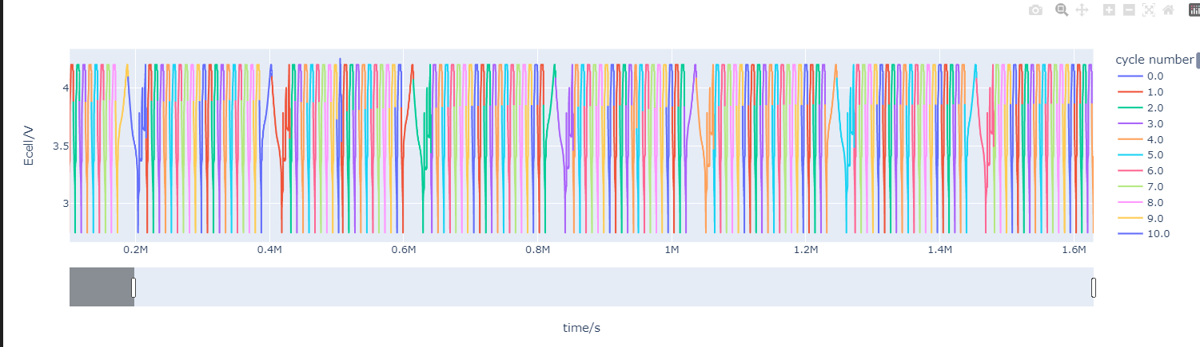
Capacity & Data Analysis
Notes:
First we needed to understand the data we were given.
This is an example timeline plot of one of cell tests.

Slide 6
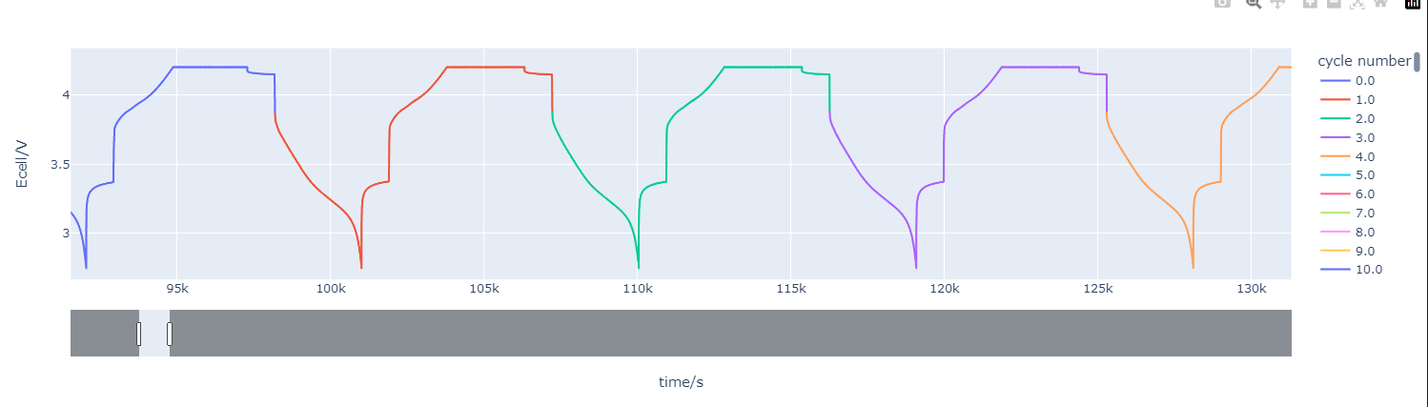
Capacity & Data Analysis
Notes:
The plot is interactive, so we can zoom in on individual cycles.
Current is hidden here, so you can’t see that there’s a sudden voltage change when the cell changes between charging and discharging.
You can see the cycle number changes when the discharge begins, but this leaves an anomaly here on the 1st cycle.
We need the capacity to relate to the ECM.
To calculate the capacity, and thus plot the cell degradation, you’d think it would be as simple as coding a numerical integrator.
Nope, because the data is wrong. These cycles are labelled incorrectly, so I’ve had to go through and scan all the data to correct this.
There’s no point training a model on incorrectly labelled data.

Slide 7
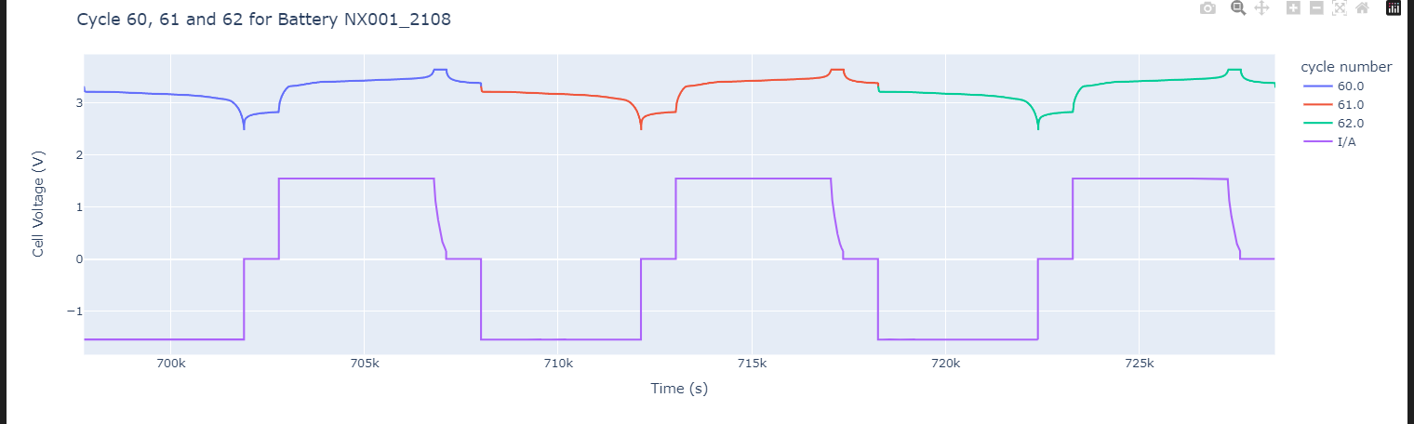
Capacity & Data Analysis
Notes:
The plot is interactive, so we can zoom in on individual cycles.
Current is hidden here, so you can’t see that there’s a sudden voltage change when the cell changes between charging and discharging.
You can see the cycle number changes when the discharge begins, but this leaves an anomaly here on the 1st cycle.
We need the capacity to relate to the ECM.
To calculate the capacity, and thus plot the cell degradation, you’d think it would be as simple as coding a numerical integrator.
Nope, because the data is wrong. These cycles are labelled incorrectly, so I’ve had to go through and scan all the data to correct this.
There’s no point training a model on incorrectly labelled data.

Slide 8
Capacity & Data Analysis
Notes:
The plot is interactive, so we can zoom in on individual cycles.
Current is hidden here, so you can’t see that there’s a sudden voltage change when the cell changes between charging and discharging.
You can see the cycle number changes when the discharge begins, but this leaves an anomaly here on the 1st cycle.
To calculate the capacity, and thus plot the cell degradation, you’d think it would be as simple as coding a numerical integrator.
Nope, because the data is wrong. These cycles are labelled incorrectly, so I’ve had to go through and scan all the data to correct this.
There’s no point training a model on incorrectly labelled data.

Slide 9
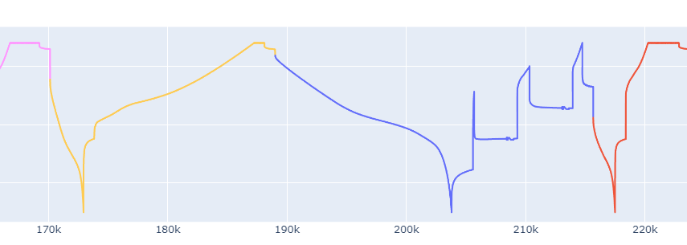
Capacity & Data Analysis
Notes:
We were also able to see some weird cycles like this.
These are the cycles where EIS has been started (right) at 33 and 66% discharge.
But what about this? (Left) Asked Lifetime on Friday, the cycle before an EIS cycle is a slow cycle. This gives a different capacity reading.

Slide 10
Capacity & Data Analysis
Notes:
We were also able to see some weird cycles like this.
These are the cycles where EIS has been started (right) at 33 and 66% discharge.
But what about this? (Left) Asked Lifetime on Friday, the cycle before an EIS cycle is a slow cycle. This gives a different capacity reading.

Slide 11
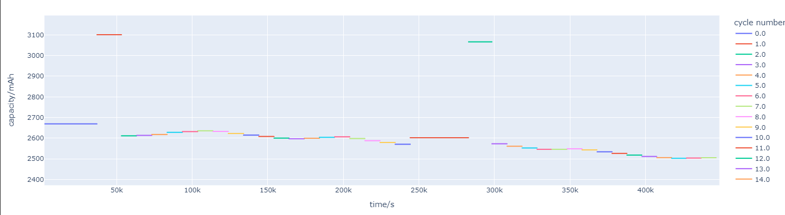
Capacity & Data Analysis
July
Notes:
This then results in a messy capacity plot which needs some tinkering, I need to filter out the EIS cycles. By plotting multiple.

Slide 12
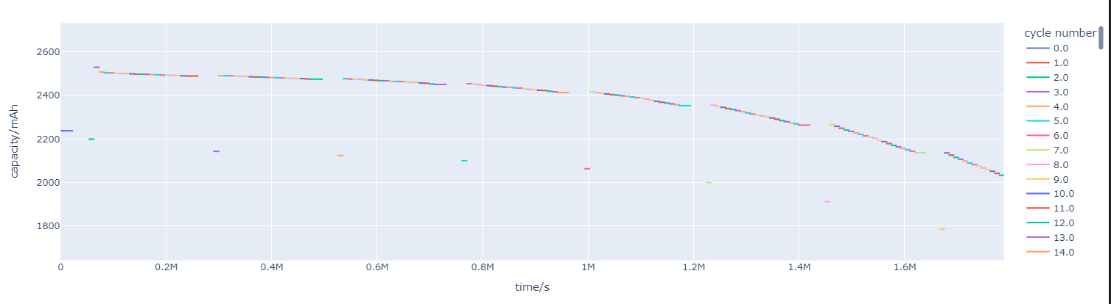
Capacity & Data Analysis
August
Notes:
We can see the degradation of this cell. Also worth noting how much longer the August tests are (4x)

Slide 13
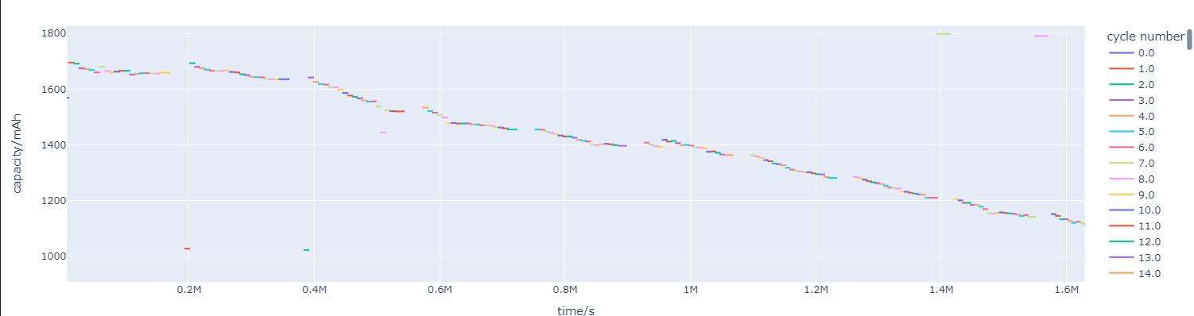
Capacity & Data Analysis
January
Notes:
We can see the degradation of this cell - what happened between August and January?

Slide 14


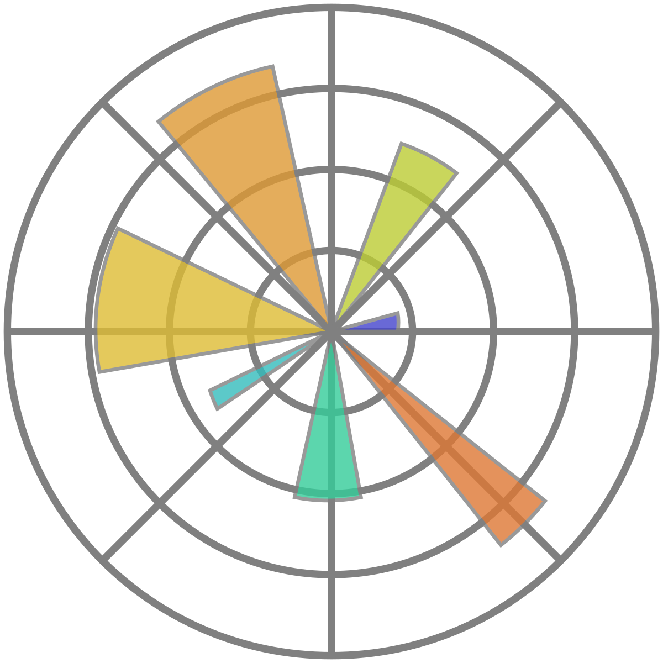




Personal and Technical Development - Joe
Notes:
Move from what I’m used to to what Amy proposed.
I still hate implicit languages, but getting far more experience with it.
Much better workflow, can’t recommend plotly enough, but pandas i’m not quite sold on.
Git wiki to make our notes and I’ve learned a lot in terms of creative effective notes for sharing knowledge and taking notes during meetings with LiFETIME.

Slide 15
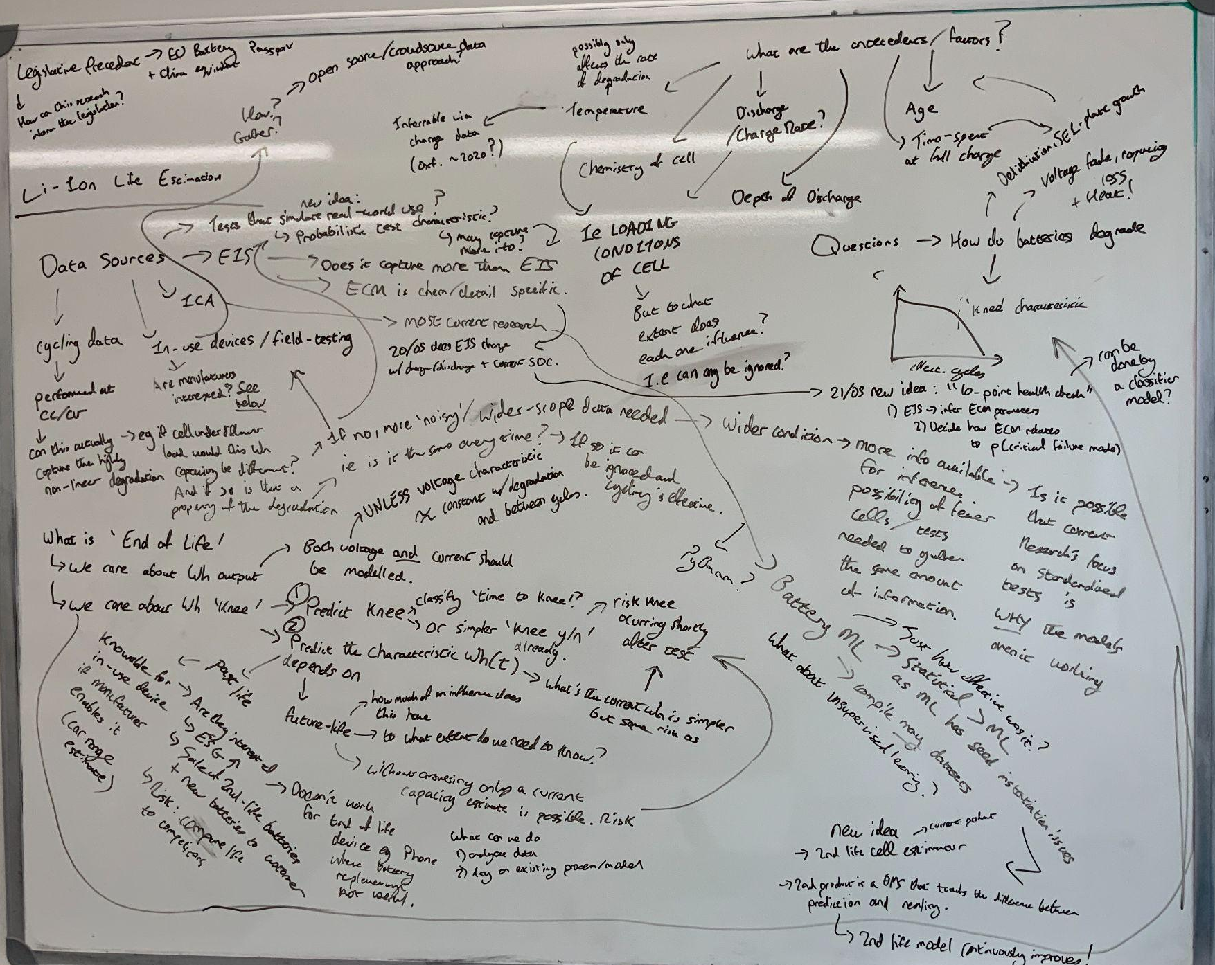
Notes:
As well as handling large amounts of research and information

Slide 16
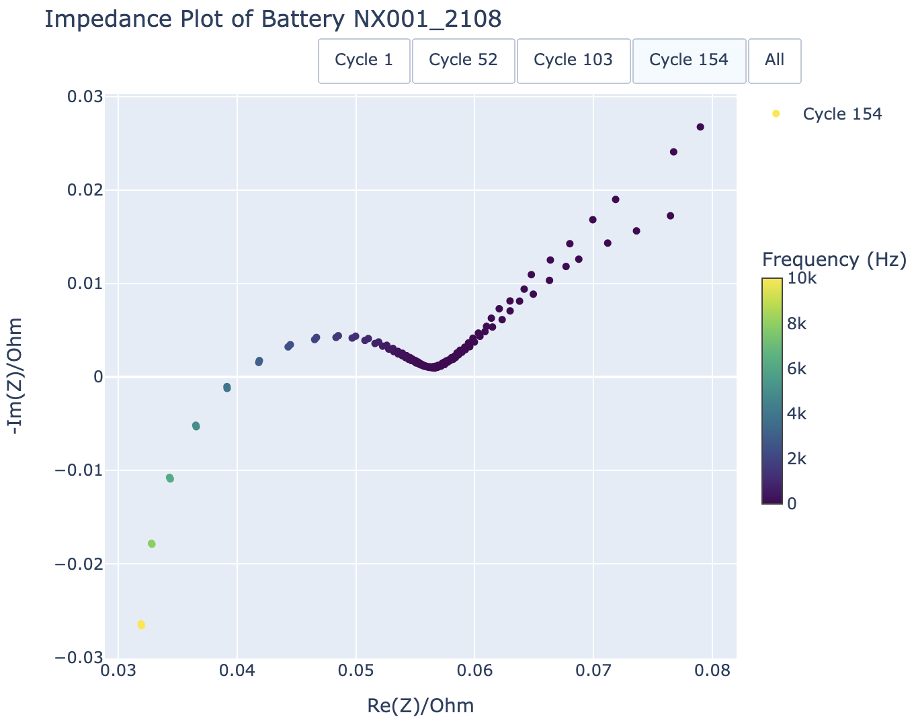
ECM and EIS

Slide 17
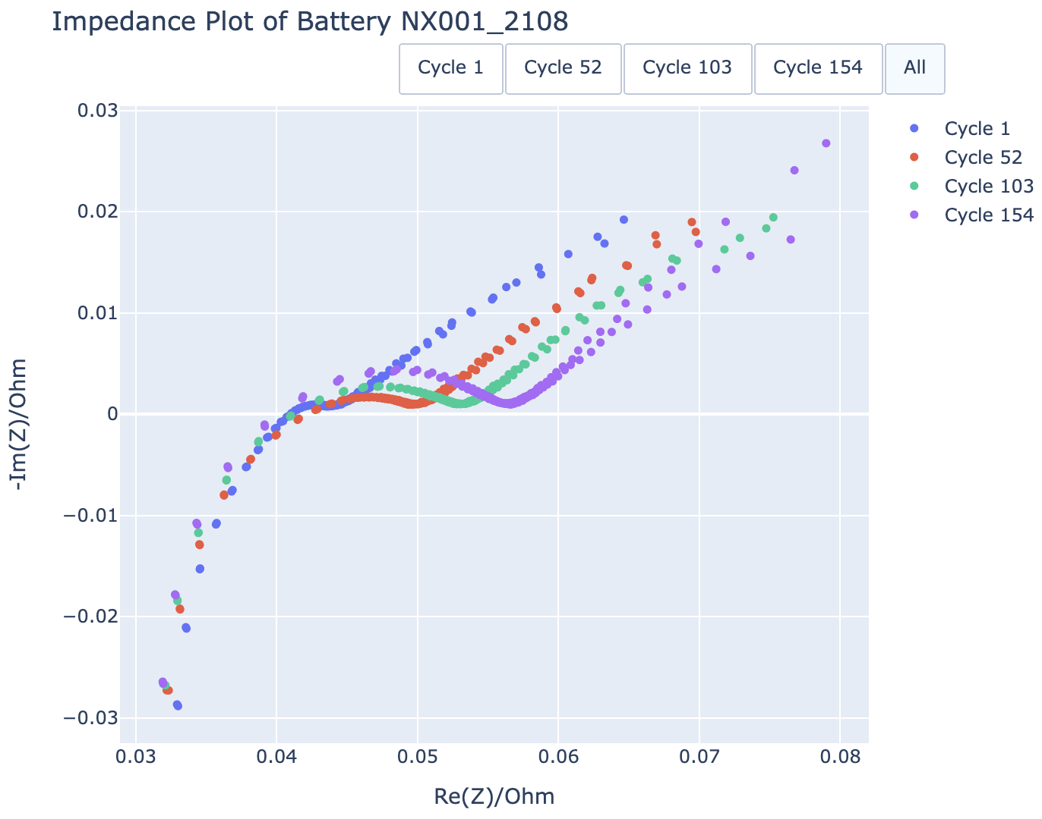

Slide 18
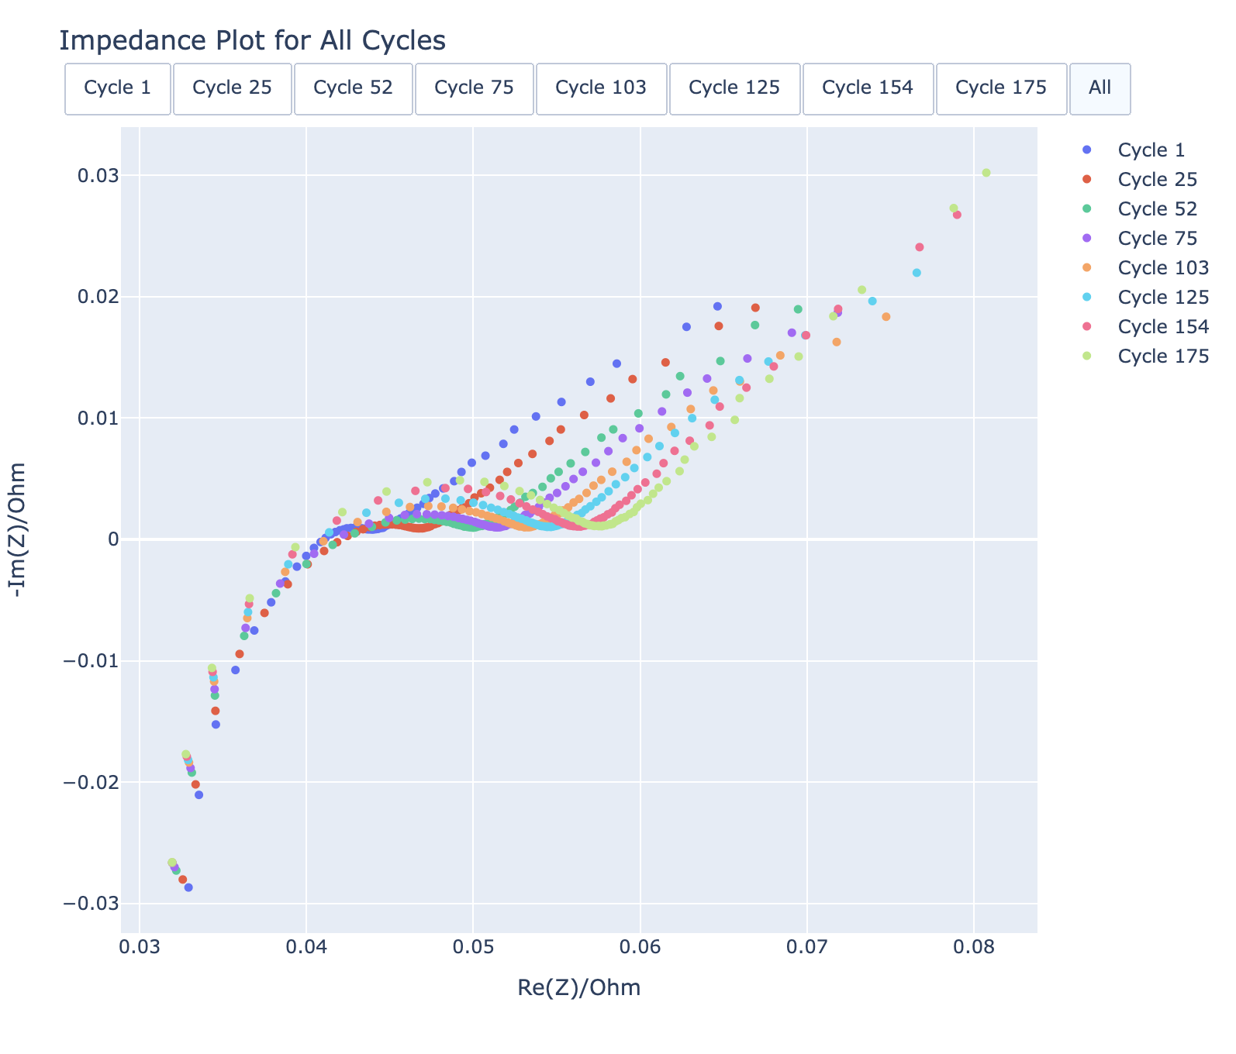
Synthetic data

Slide 19
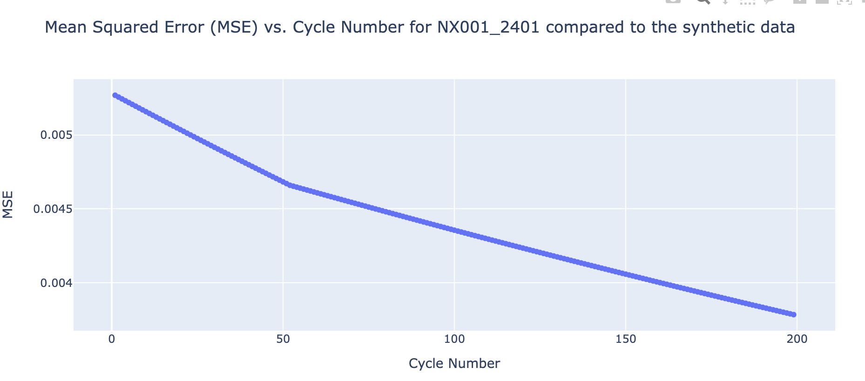
Batteries degrade, even when not used…
Two tests, done in August 2023 and January 2024

Slide 20
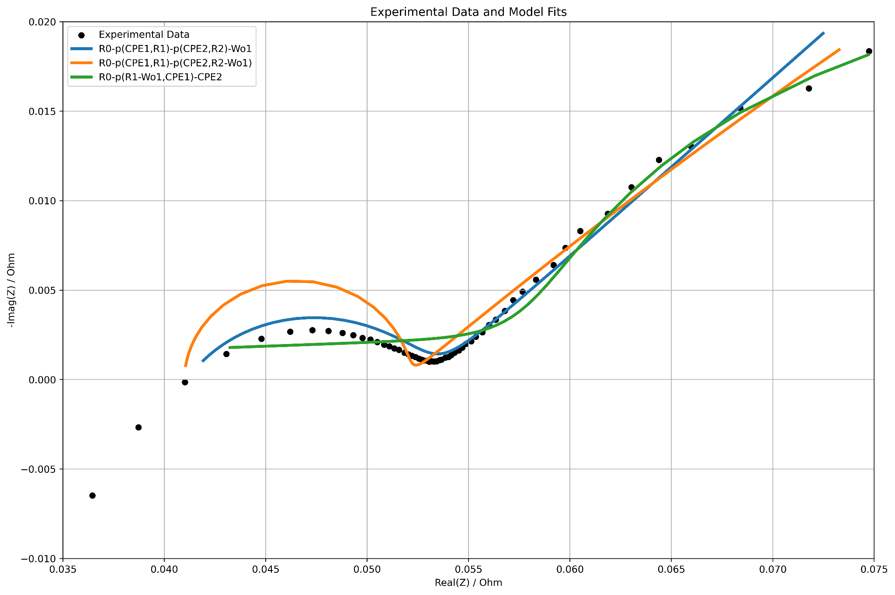
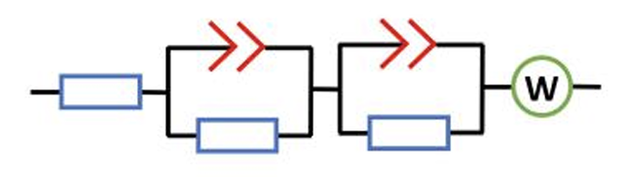
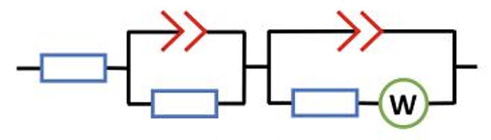
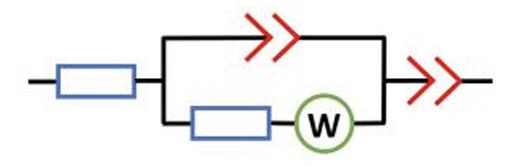
Fitting an ECM

Slide 21
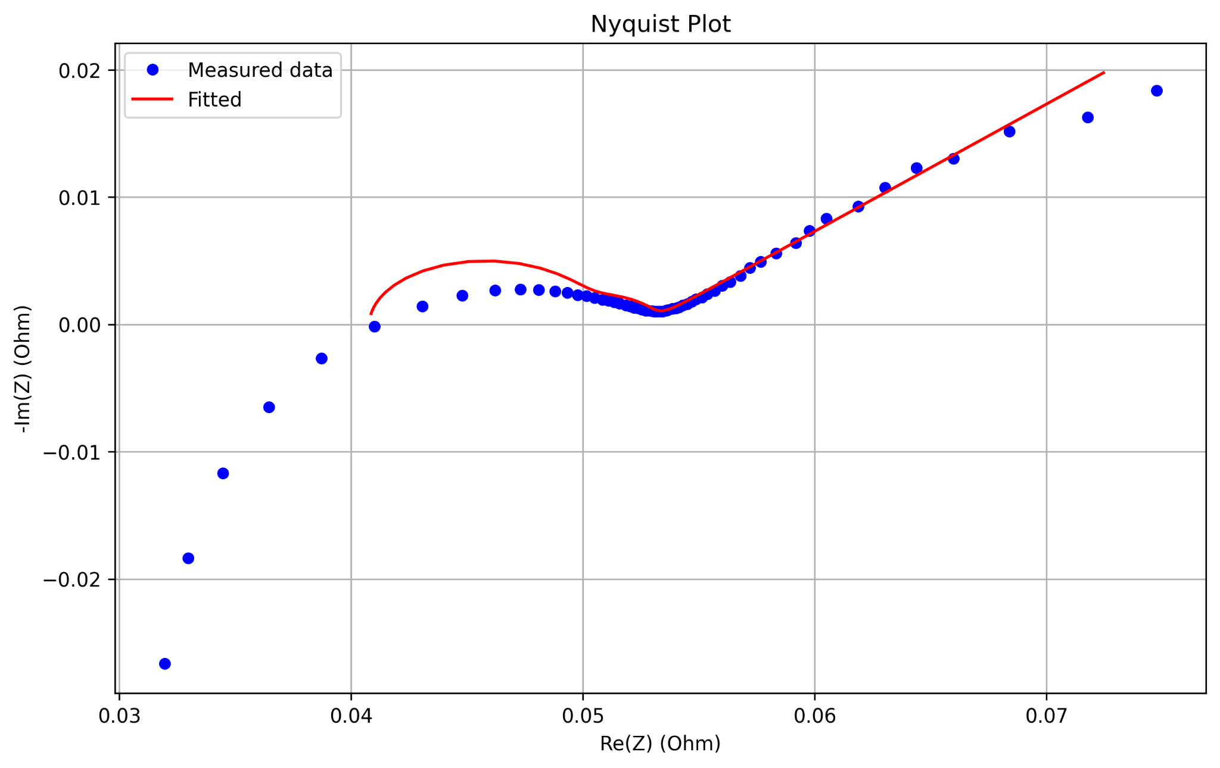
Issues with mean square error (MSE) weighting

Slide 22
Is it feasible?

Slide 24
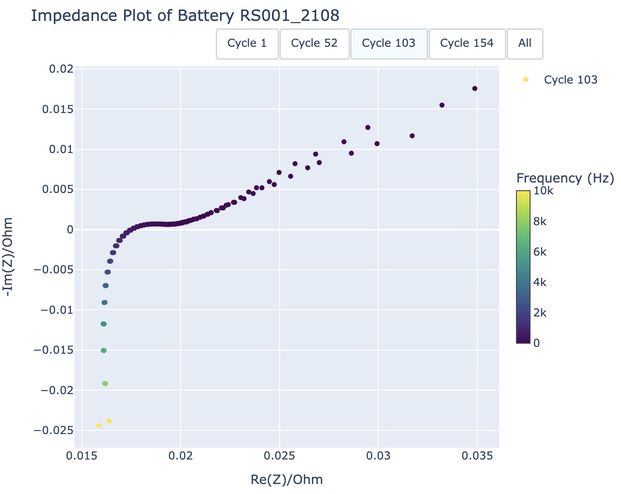
Spectra differ for different battery types

Slide 25
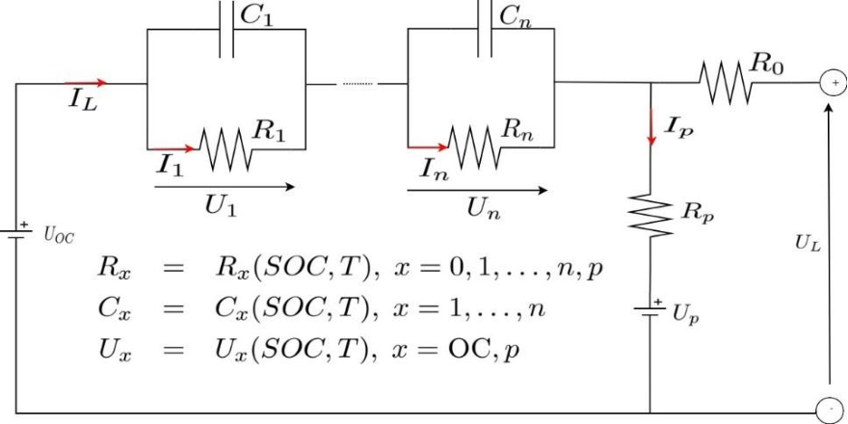
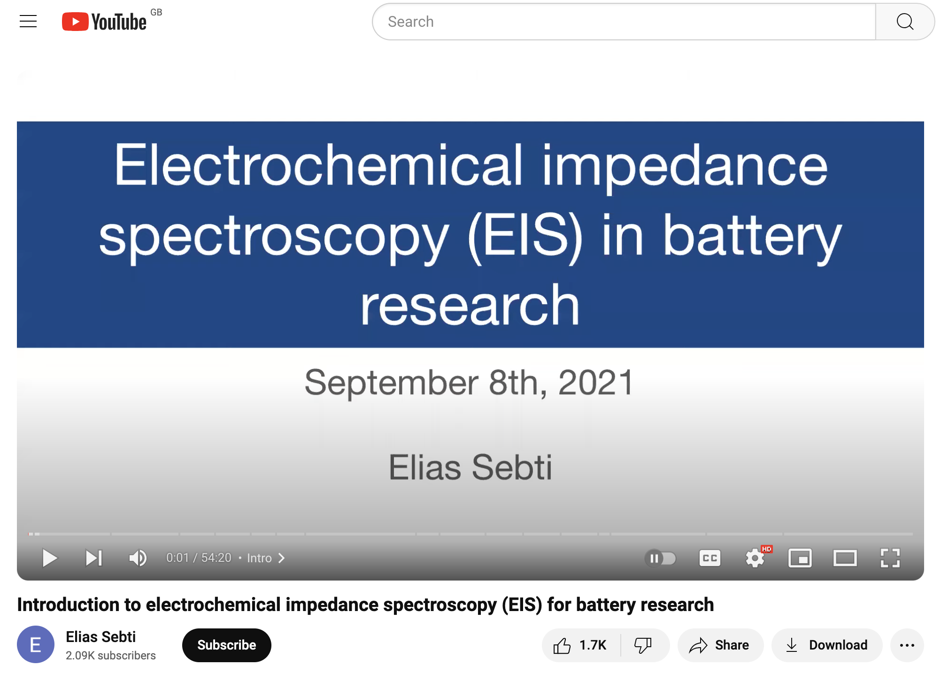


Personal and Technical Development - Amy

Slide 26
Problems Encountered:
Task Start
Objective
Progress
Notes:
(Joe)
As with any project involving more than one person, our primary issue has been communication of relevant information.
To tackle this problem we now keep this log with what’s been said email chains since that information tends to get lost and meetings s
Examples include: - We were supplied with the data, but it had no explanatory notes kept with it.
-> We didn’t know what cells were tested. -> Relevant to know what ECM model to build, whether your capacity analysis is correct.
-> How they were tested. -> ECM analysis that was done affects capacity calculations, the test procedure was changed during the course of tests (Temperature control). Additionally, unknown what state of charge the cells were at when ECM was conducted.
-> How the data was labelled -> the data had to be plotted to determine at what point the “cycle number” was incremented. On Friday we realised that this was labelled incorrectly. The date codes weren’t sufficient, as we only realised that the January tests were after the July tests after calculating cell degradation.
-> no git access
-> different team members did different things, and lack awareness or expertise with regards to what others did.
There’s no certainty due to a lack of documentation only “I think I remember it being this”
The lesson here is obvious. If your work is going to be seen by anyone but you, document it! at minimum include a readme in the folder.
Another issue is that we still don’t have access to their git. That’s influenced our direction (ECM EIS vs ICA), since there’s no point in creating code that calculates the ICA curve when they’ve already done that. We also can’t build on their work.

Slide 27
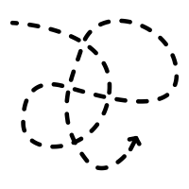
Problems Encountered:
Progress
Task Start
Objective
New objective
Notes:
(Joe)
As with any project involving more than one person, our primary issue has been communication of relevant information.
To tackle this problem we now keep this log with what’s been said email chains since that information tends to get lost and meetings s
Examples include: - We were supplied with the data, but it had no explanatory notes kept with it.
-> We didn’t know what cells were tested. -> Relevant to know what ECM model to build, whether your capacity analysis is correct.
-> How they were tested. -> ECM analysis that was done affects capacity calculations, the test procedure was changed during the course of tests (Temperature control). Additionally, unknown what state of charge the cells were at when ECM was conducted.
-> How the data was labelled -> the data had to be plotted to determine at what point the “cycle number” was incremented. On Friday we realised that this was labelled incorrectly. The date codes weren’t sufficient, as we only realised that the January tests were after the July tests after calculating cell degradation.
-> no git access
-> different team members did different things, and lack awareness or expertise with regards to what others did.
There’s no certainty due to a lack of documentation only “I think I remember it being this”
The lesson here is obvious. If your work is going to be seen by anyone but you, document it! at minimum include a readme in the folder.
Another issue is that we still don’t have access to their git. That’s influenced our direction (ECM EIS vs ICA), since there’s no point in creating code that calculates the ICA curve when they’ve already done that. We also can’t build on their work.

Slide 28
Documentation is everything.
Notes:
(Joe)
As with any project involving more than one person, our primary issue has been communication of relevant information.
To tackle this problem we now keep this log with what’s been said email chains since that information tends to get lost and meetings s
Examples include: - We were supplied with the data, but it had no explanatory notes kept with it.
-> We didn’t know what cells were tested. -> Relevant to know what ECM model to build, whether your capacity analysis is correct.
-> How they were tested. -> ECM analysis that was done affects capacity calculations, the test procedure was changed during the course of tests (Temperature control). Additionally, unknown what state of charge the cells were at when ECM was conducted.
-> How the data was labelled -> the data had to be plotted to determine at what point the “cycle number” was incremented. On Friday we realised that this was labelled incorrectly. The date codes weren’t sufficient, as we only realised that the January tests were after the July tests after calculating cell degradation.
-> no git access
-> different team members did different things, and lack awareness or expertise with regards to what others did.
There’s no certainty due to a lack of documentation only “I think I remember it being this”
The lesson here is obvious. If your work is going to be seen by anyone but you, document it! at minimum include a readme in the folder.
Another issue is that we still don’t have access to their git. That’s influenced our direction (ECM EIS vs ICA), since there’s no point in creating code that calculates the ICA curve when they’ve already done that. We also can’t build on their work.

Slide 29
Key Issues Faced
We still don’t have access to LiFETIME’s GitHub
Difficulty with data due to general lack of documentation of the data
The LiFETIME team are pretty busy
Notes:
We still don’t have access to LiFETIME’s GitHub until last Friday despite our pestering, which was a shame but it hasn’t stopped us making progress in other areas
Difficulty with data, unclear labelling and naming conventions and general lack of documentation of the data slowed us down. It’s not entirely cleared up yet, we still are waiting for some clarification as Nicolas is checking details for us.
The LiFETIME team are pretty busy, and they all have different areas of expertise so when we’ve met with one or two members they weren’t always able to answer every question we had

Slide 30
Plan
Clean, process and visualise the EIS data
Document the data
Choose an ECM, using literature and our EIS data, building on current progress
Get a better picture of how each ECM component links to a physical aspect of the cell
Fit the parameters of the ECM for a single SOC, cycle number and battery type
Quantitatively report whether the ECM is valid for the other battery types
Investigate how the ECM parameters change with SOC and cycle number
Notes:
(AMY)

Slide 31
Plan
Clean, process and visualise the EIS data
Document the data
Choose an ECM, using literature and our EIS data, building on current progress
Get a better picture of how each ECM component links to a physical aspect of the cell
Fit the parameters of the ECM for a single SOC, cycle number and battery type
Quantitatively report whether the ECM is valid for the other battery types
Investigate how the ECM parameters change with SOC and cycle number
Notes:
Clean, process and visualise the EIS data.
Document the data to a high level, so that anyone looking to use the data in the future doesn’t have to figure it all out like we did.
Choose an ECM, using literature and our EIS data. We can just replicate an ECM from literature, or create a unique one to match our EIS data.
Get a good picture of how each ECM component links to a physical aspect of the cell through literature review, and document this.
Fit the parameters of the ECM for a single SOC, cycle number and battery type
Investigate whether the ECM is valid for the other battery types, find the error quantitively
Investigate how the parameters change with SOC and cycle number

Slide 32
Project Plan
Proposal Presentation
Present initial findings from literature review and suggested avenues forward. Received feedback on feasibility of our plans.
Project Start
Literature review.
Wednesday 15th
Monday 20th
Fri 10th
Thursday 16th
2nd meeting with LiFETIME
Gave our proposal for our new objective, received feedback and agreed on direction.
First meeting with LiFETIME
Obtained necessary data and discussed initial research.

Slide 33
Project Plan
Third Meeting with LiFETIME
First full team meeting. Presented our progress and discussed fixing our errors.
Final Presentation
Monday 27th
Thursday 6th
Friday 24th
Tuesday 4th
Interim Presentation
Presenting our progress and our new direction, specifically how we plan to use the remaining time.
Documentation Completion

